Slide 1
Computer Networks
[Types of Transmission Media]

Slide 2
Network Devices
Transmission media is the physical medium through which data is transmitted from one device to another within a network. These media can be wired or wireless. The choice of medium depends on factors like distance, speed, and interference.

Slide 3
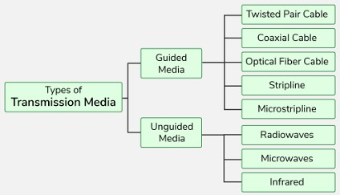
What is Transmission Media in Computer Networks?
A transmission media is a physical path between the transmitter and the receiver i.e. it is the path along which data is sent from one device to another.
Transmission Media is broadly classified into the following types.

Slide 4
Guided Media
Guided Media is also referred to as Wired or Bounded transmission media.
Signals being transmitted are directed and confined in a narrow pathway by using physical links.
Features:
High Speed
Secure
Used for comparatively shorter distances

Slide 5
There are 3 major types of Guided Media:
Twisted Pair Cable
Coaxial Cable
Optical Fiber Cable

Slide 6
Twisted Pair Cable
It consists of 2 separately insulated conductor wires twisted about each other.
Generally, several such pairs are bundled together in a protective sheath. They are the most widely used Transmission Media.
Twisted Pair is of two types:
Unshielded Twisted Pair (UTP)
Shielded Twisted Pair (STP)

Slide 7

Unshielded Twisted Pair (UTP)
UTP consists of two insulated copper wires twisted around one another. This type of cable has the ability to block interference and does not depend on a physical shield for this purpose.
It is used for telephonic applications.

Slide 8
Unshielded Twisted Pair
Advantages
Least expensive
Easy to install
High-speed capacity
Disadvantages
Lower capacity and performance in comparison to STP
Short distance transmission due to attenuation

Slide 9
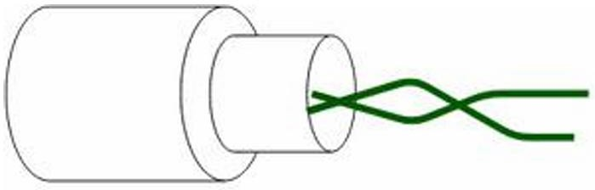
Shielded Twisted Pair (STP)
Shielded Twisted Pair (STP) cable consists of a special jacket (a copper braid covering or a foil shield) to block external interference.
It is used in fast data rate Ethernet and in voice and data channels of telephone lines.

Slide 10
Shielded Twisted Pair
Advantages
Better performance at a higher data rate in comparison to UTP
Eliminates crosstalk
Comparatively faster
Disadvantages
Comparatively difficult to install and manufacture
More expensive
Bulky

Slide 11
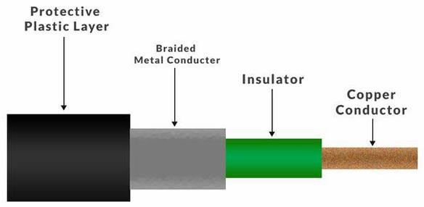
Coaxial Cable
Coaxial cable has an outer plastic covering containing an insulation layer made of PVC or Teflon and 2 parallel conductors each having a separate insulated protection cover.
The coaxial cable transmits information in two modes:
Baseband mode(dedicated cable bandwidth) and Broadband mode(cable bandwidth is split into separate ranges).
Cable TVs and analog television networks widely use Coaxial cables.

Slide 12
Coaxial Cable
Advantages
Disadvantages
Coaxial cables are expensive.
Coaxial cables has high
bandwidth .
It is easy to install.
The coaxial cable must be
grounded in order to prevent any
Coaxial cables are more reliable
crosstalk.
and durable.
As a Coaxial cable has multiple
Less affected by noise or cross-
layers it is very bulky.
talk or electromagnetic
There is a chance of breaking the
inference.
coaxial cable and attaching a “t-
Coaxial cables support multiple
joint” by hackers, this
channels.
compromises the security of the
data

Slide 13
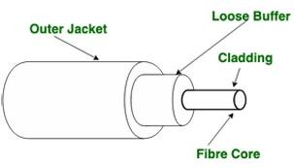
Optical Fiber Cable
Optical Fibre Cable uses the concept of total internal reflection of light through a core made up of glass.
The core is surrounded by a less dense glass or plastic covering called the coating. It is used for the transmission of large volumes of data. The cable can be unidirectional or bidirectional.
The WDM (Wavelength Division Multiplexer) supports two modes, namely unidirectional and bidirectional mode.

Slide 14
Optical Fiber Cable
Advantages
Increased capacity and bandwidth
Lightweight
Less signal attenuation
Immunity to electromagnetic interference
Resistance to corrosive materials
Disadvantages
Difficult to install and maintain
High cost

Slide 15
Applications of Optical Fibre Cable
Medical Purpose: Used in several types of medical instruments.
Defence Purpose: Used in transmission of data in aerospace.
For Communication: This is largely used in formation of internet cables.
Industrial Purpose: Used for lighting purposes and safety measures in designing the interior and exterior of automobiles.

Slide 16
Stripline
Stripline is a transverse electromagnetic (TEM) transmission line medium invented by Robert M. Barrett of the Air Force Cambridge Research Centre in the 1950s.
Stripline is the earliest form of the planar transmission line.
It uses a conducting material to transmit high-frequency waves it is also called a waveguide.
This conducting material is sandwiched between two layers of the ground plane which are usually shorted to provide EMI immunity.

Slide 17
Microstripline
A microstripline is a type of transmission media used to carry high-frequency signals, commonly found in microwave and radio frequency circuits.
It consists of a flat, narrow conducting strip (usually made of metal) placed on top of a dielectric material (an insulating layer), with a metal ground plane on the other side.

Slide 18
Unguided Media
It is also referred to as Wireless or Unbounded transmission media .
No physical medium is required for the transmission of electromagnetic signals.
Features of Unguided Media
The signal is broadcasted through air
Less Secure
Used for larger distances
There are 3 types of Signals transmitted through unguided media:
Radiowaves
Microwaves
infrared

Slide 19
Radio Waves
Radio waves are easy to generate and can penetrate through buildings. The sending and receiving antennas need not be aligned.
Frequency Range: 3KHz - 1GHz.
AM and FM radios and cordless phones use Radio waves for transmission.
Types of Radio Waves:
Short Wave: AM Radio
VHF (Very High Frequency): FM Radio/TV
UHF (Ultra High Frequency): TV

Slide 20
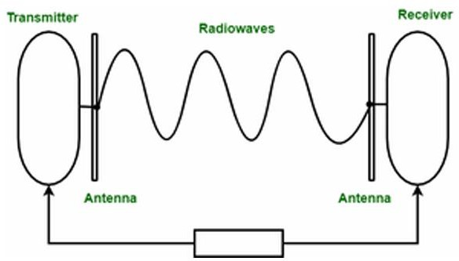
Radio Wave Components
Transmitter: Responsible for encoding the signal.
Receiver: Responsible for decoding the signal

Slide 21
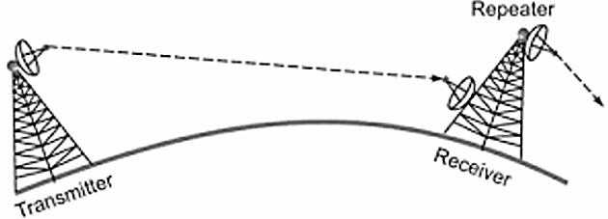
Microwaves
It is a line of sight transmission i.e. the sending and receiving antennas need to be properly aligned with each other.
The distance covered by the signal is directly proportional to the height of the antenna.
Frequency Range: 1GHz - 300GHz.
Micro waves are majorly used for mobile phone communication and television distribution.

Slide 22
Microwaves
Advantages
Cheaper than using cables
Freedom from land acquisition
Ease of communication in difficult terrains
Communication over oceans
Disadvantages
Insecure communication.
Out of phase signal.
Susceptible to weather conditions.
Bandwidth is limited.
High cost of design, implementation, and maintenance.

Slide 23
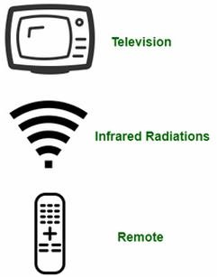
Infrared
Infrared waves are used for very short distance communication. They cannot penetrate through obstacles. This prevents interference between systems.
Frequency Range: 300GHz – 400THz. It is used in TV remotes, wireless mouse, keyboard, printer, etc

Slide 24
Difference Between Radio Waves, Microwaves, and Infrared Waves
Basis | Radiowave | Microwave | Infrared Wave
Direction | These are omni directional in nature. | These are unidirectional in nature. | These are unidirectional in nature.
Penetration | At low frequency, they can penetrate through solid objects and walls but high frequency they bounce off the obstacle. | At low frequency, they can penetrate through solid objects and walls. at high frequency, they cannot penetrate. | They cannot penetrate through any solid object and walls.
Frequency range | Frequency range: 3 KHz to 1GHz. | Frequency range: 1 GHz to 300 GHz. | Frequency range: 300 GHz to 400 GHz.
Security | These offers poor security. | These offers medium security. | These offers high security.
Attenuation | Attenuation is high. | Attenuation is variable. | Attenuation is low.
Government License | Some frequencies in the radio- waves require government license to use these. | Some frequencies in the microwaves require government license to use these. | There is no need of government license to use these waves.
Usage Cost | Setup and usage Cost is moderate | Setup and usage Cost is high. | Usage Cost is very less
Communication | These are used in long distance communication. | These are used in long distance communication. | These are not used in long distance communication.

Slide 25
Causes of Transmission Impairment
Transmission impairment refers to the loss or distortion of signals during data transmission, leading to errors or reduced quality in communication.
Common causes include signal distortion, attenuation, and noise all of which can affect the clarity and reliability of transmitted data.

Slide 26
Causes of Transmission Impairment
Attenuation: It means loss of energy. The strength of signal decreases with increasing distance which causes loss of energy in overcoming resistance of medium. This is also known as attenuated signal.
Amplifiers are used to amplify the attenuated signal which gives the original signal back and compensate for this loss.

Slide 27
Causes of Transmission Impairment
Distortion: It means changes in the form or shape of the signal. This is generally seen in composite signals made up with different frequencies.
Each frequency component has its own propagation speed travelling through a medium. And thats why it delay in arriving at the final destination. Every component arrive at different time which leads to distortion.
Therefore, they have different phases at receiver end from what they had at senders end.

Slide 28
Causes of Transmission Impairment
Noise: The random or unwanted signal that mixes up with the original signal is called noise. There are several types of noise such as induced noise, crosstalk noise, thermal noise and impulse noise which may corrupt the signal.

Slide 29
Factors Considered for Designing the Transmission Media
Bandwidth: Assuming all other conditions remain constant, the greater a medium’s bandwidth, the faster a signal’s data transmission rate.
Transmission Impairment : Transmission Impairment occurs when the received signal differs from the transmitted signal. Signal quality will be impacted as a result of transmission impairment.
Interference: Interference is defined as the process of disturbing a signal as it travels over a communication media with the addition of an undesired signal.

Slide 30
Applications of Transmission Media in Computer Networks
Transmission media in computer networks are used to connect devices and transfer data. Here are some common applications:
Transmission Media | Application
Unshielded Twisted Pair (UTP) | Local Area Networks (LAN), telephones
Shielded Twisted Pair (STP) | Industrial networks, environments with high interference
Optical Fiber Cable | Long-distance communication, internet backbones
Coaxial Cable | Cable TV, broadband internet, CCTV
Stripline | Printed Circuit Boards (PCBs), microwave circuits
Microstripline | Antennas, satellite communication, RF circuits
Radio | Wireless communication, AM/FM radio, mobile phones
Infrared | Remote controls, short-range communication
Microwave | Satellite communication, radar, long-distance links

